Slide 1
The God of Creation
Who is He?

Slide 2
Some Very Important Questions
Origin : Where did I come from?
Meaning : Why am I alive?
Morality : How to know right from wrong?
Destiny : What happens after I die?
The answer to the first question is critical to all of the others!

Slide 3
If you saw some blocks stacked on a table, what would you think?
Where did they come from?
How did they get stacked up like this?
Are you 100% certain?

Slide 4
A man comes to the hospital with chest pain…
* The doctor decides what is the problem and what to do.
* Is the doctor 100% certain?
* What would you do?

Slide 5
100% Certainty Is Rare
We often choose between two options based on “most probable.”
We don’t have enough time to get perfect information.
Life requires choices – sometimes, with very important results

Slide 6
You decide which is most probable
Evolution and Creation can both be studied by science, but both require faith (believing unseen events from the past).
We have been taught that evolution is fact proven by science. This is NOT true.
Be open to think for yourself.
Life requires choices – sometimes, with very important consequences!

Slide 7
Where did everything come from? Two Ideas:
Evolution Creation
Everything came from A powerful Creator
nothing made everything
Life began by accident Life was created
Complex creatures Each living creature was
developed by a series designed and made
of random accidents by their Creator

Slide 8
If you hear a loud “BANG,” which is the most probable cause:
OR

Slide 9
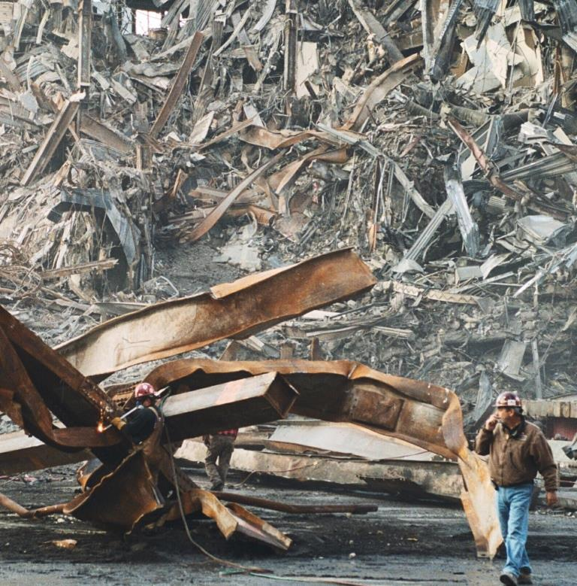
If you have an uncontrolled explosion, what is the most probable result:
OR

Slide 10
Two realities of science:
1. Something doesn’t come from nothing
(first law of thermodynamics)
2. Intelligent designs do not arise by accident
(statistical information theory)

Slide 11
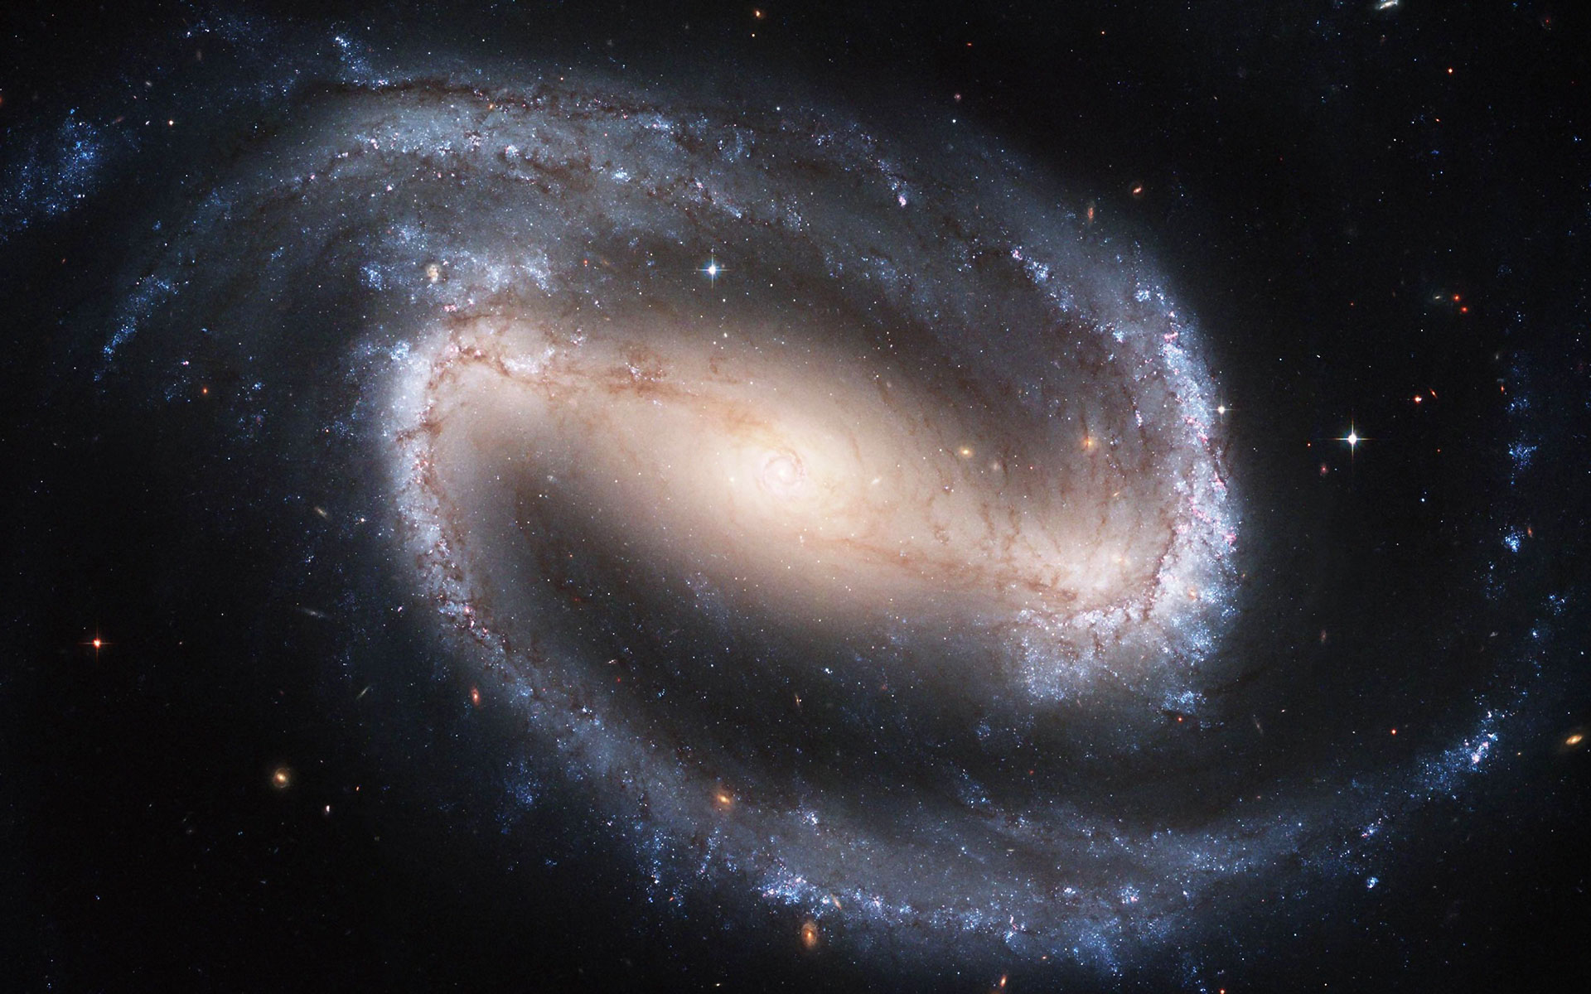
Did this come from nothing?

Slide 12
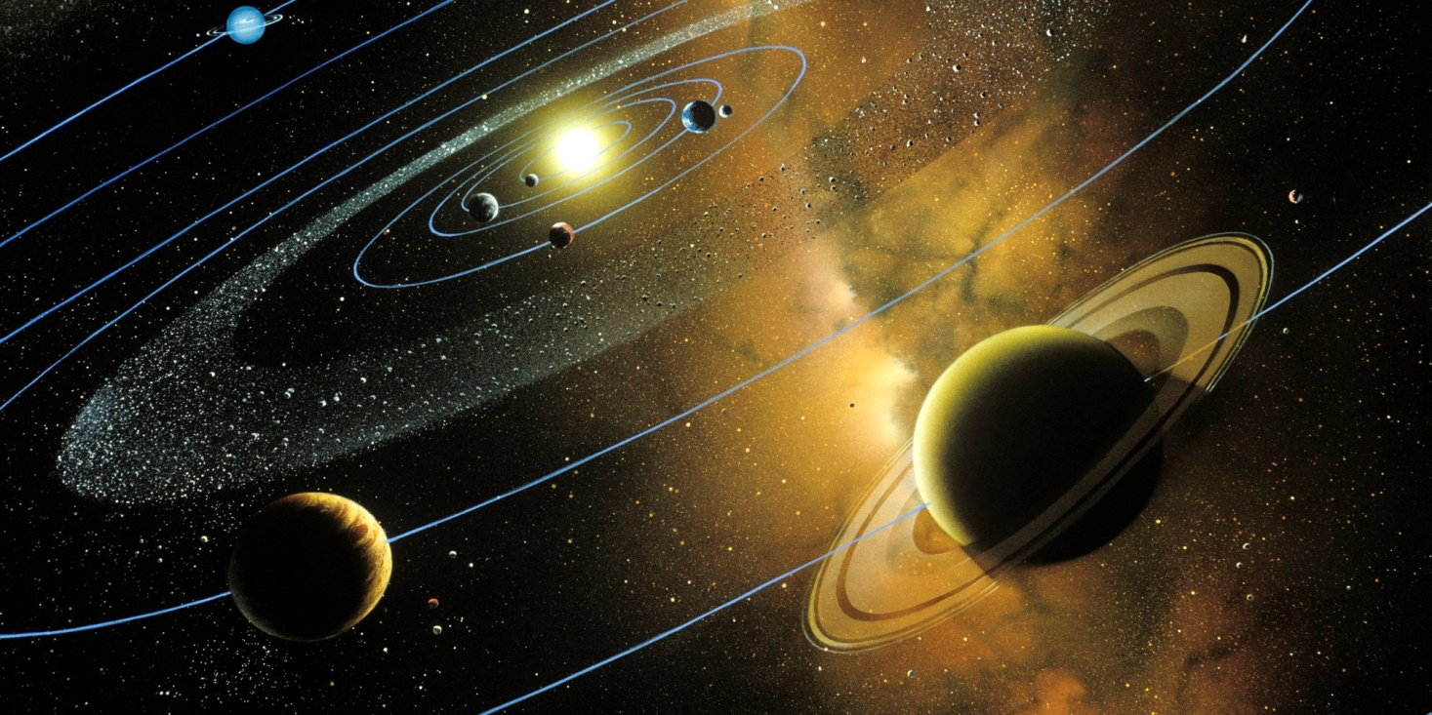
Did this design arise by accident?

Slide 13
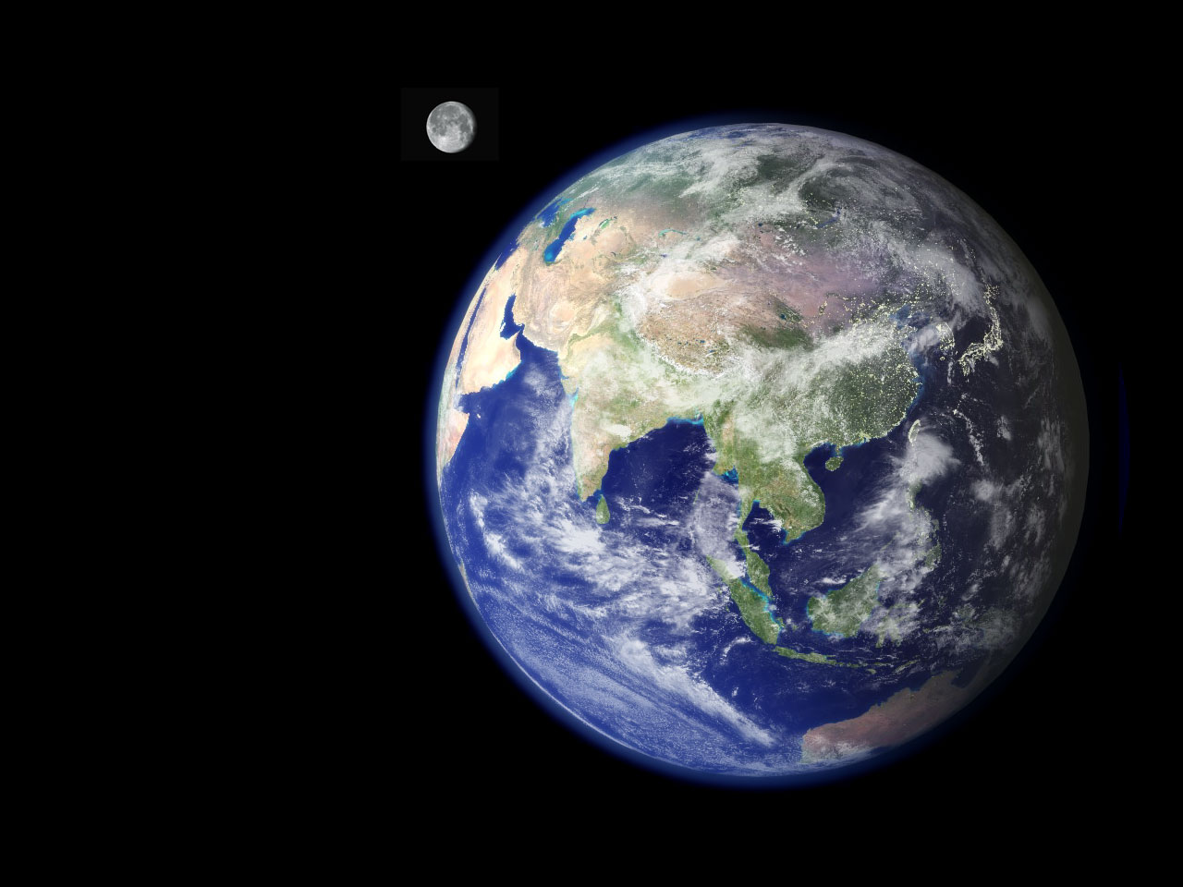
Was this planet designed for life?

Slide 14
You decide – which is most probable?
Evolution Creation
Everything came from A powerful Creator
nothing made everything

Slide 15
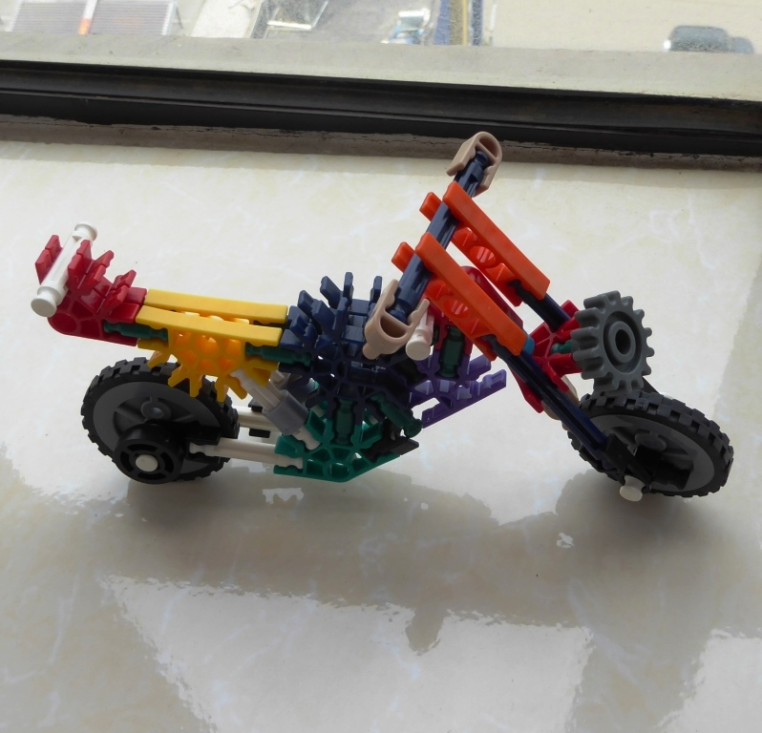
What is the difference?

Slide 16
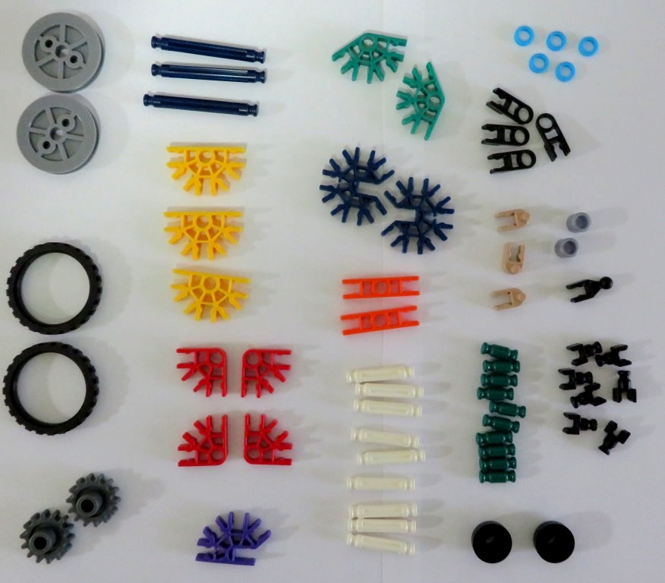
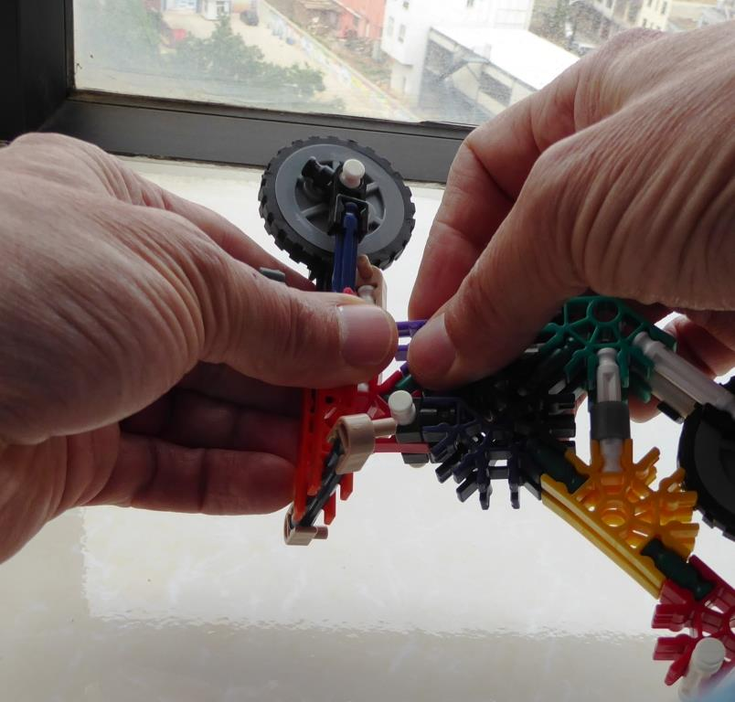
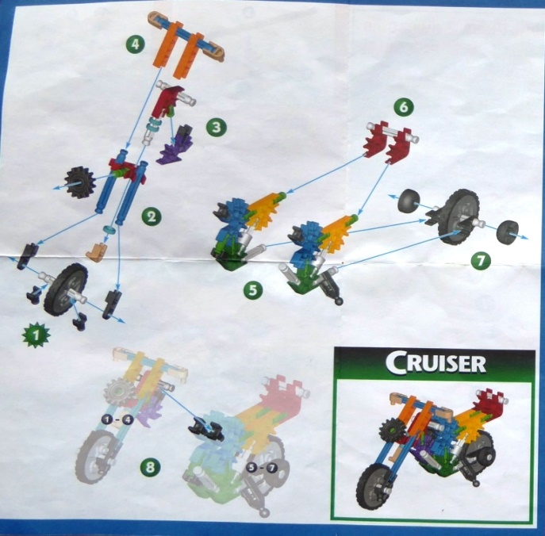
How to change? this into this
You need
and
The Right Pieces,
(66 pieces / 19 types)
a Design,
and a Process

Slide 17
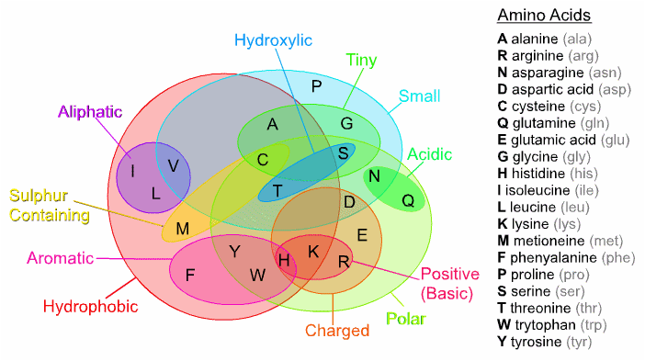
Proteins, the “building blocks of life” are made from Amino Acids

Slide 18
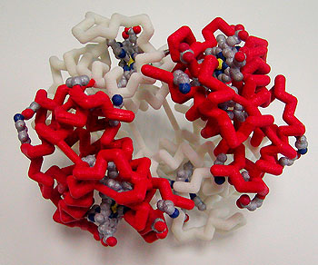
Hemoglobin, essential for life

Slide 19
What is the difference?
Not much!
Similar number of parts
Must be assembled in exact order to work

Slide 20
How to make this?
You need:
The right pieces
A design
A process

Slide 21
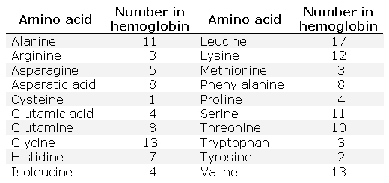
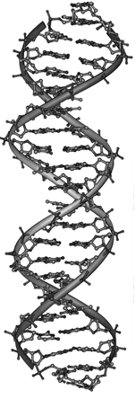
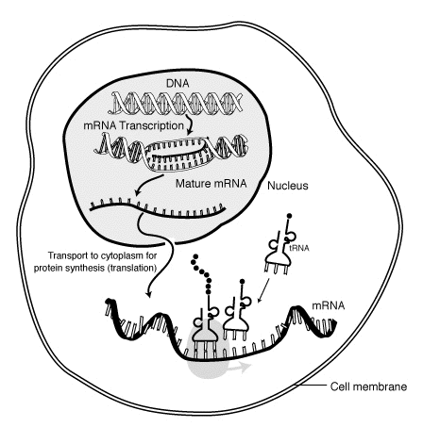
Specifically, you need: this this, and this
The Right Pieces,
(148 pieces / 20 types)
the Design,
and a Process

Slide 22
You decide – which is most probable?
Evolution Creation
Everything came from A powerful Creator
nothing made everything
Life began by accident Life was created

Slide 23
Every complex thing requires a design and a builder
No design + No builder = No house

Slide 24
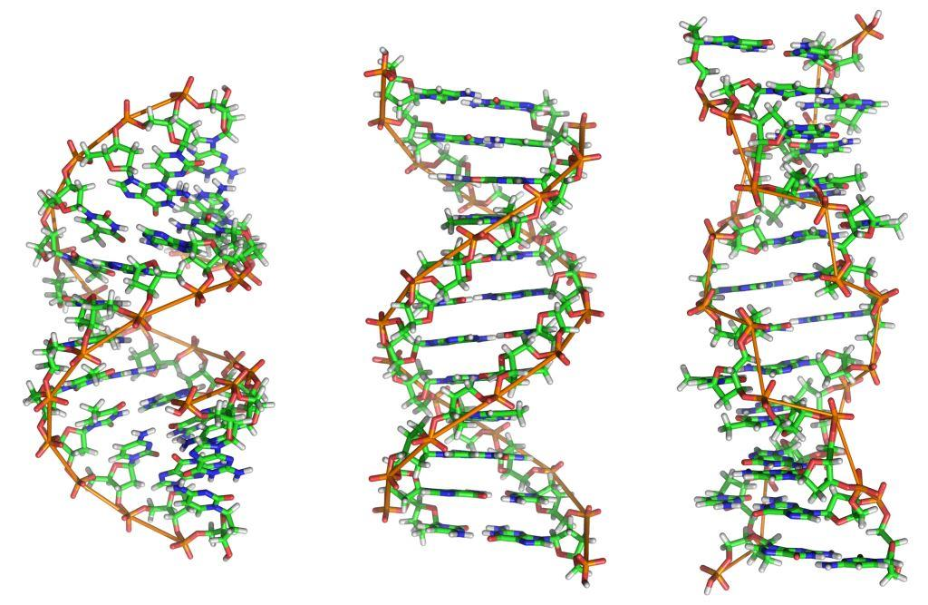
The design of life : DNA

Slide 25
Evolution requires unguided, step-by-step improvements
But even simple machines do not work without all of the pieces in the right places

Slide 26
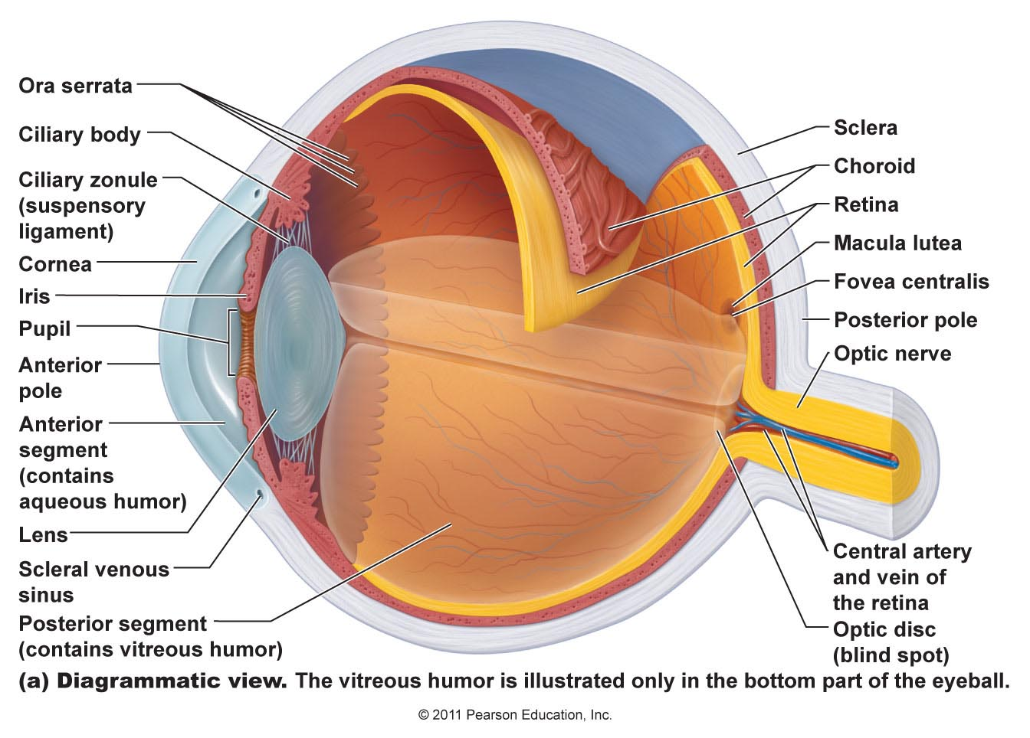
Your eye – a very complex machine
Origin of the Species – Charles Darwin

Slide 27
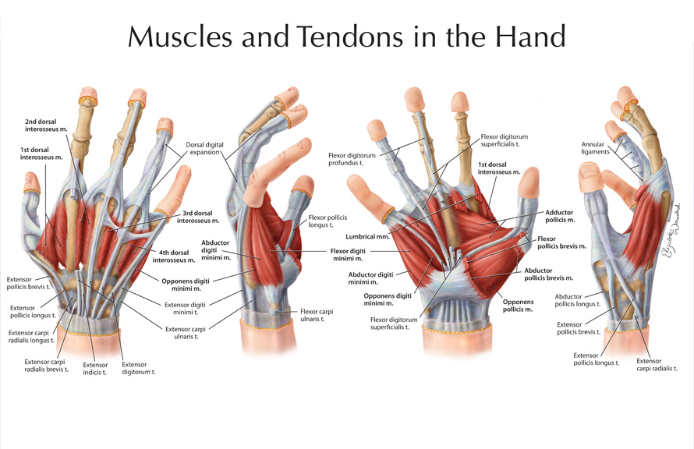
What does this look like to you? Design or Accident?

Slide 28
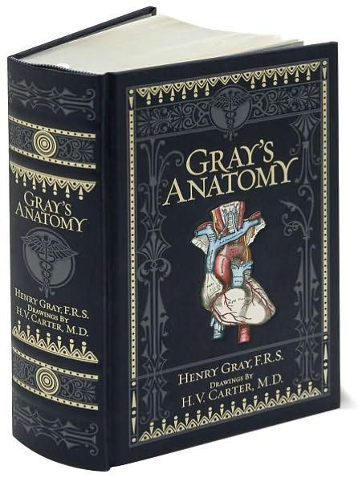
Is it reasonable to think this book could emerge by accident?
How about the human body it describes?

Slide 29
You decide – which is most probable?
Evolution Creation
Everything came from A powerful Creator
nothing made everything
Life began by accident Life was created
Complex creatures Each living creature was
developed by a series designed and made
of random accidents by their Creator

Slide 30
From the Bible
Genesis 1:1
In the beginning, God created the heavens and the earth.
起初， 神创造天地。

Slide 31
What is Faith?
Faith : believing something that you cannot see
(everyone has faith in something)
By faith we understand that the universe was created by the word of God, so that what is seen was not made out of things that are visible. Hebrews 11:3
因着信，我们就明白宇宙 是因着神的话造成的。这样，那看得见的就是从那看不见的造出来的。

Slide 32
The Story of Creation – Genesis 1
Light (v.3-5), separated light / dark to make day / night.
Atmosphere (v.6-8), oxygen and clouds
Dry land and plants (v.9-13)
Sun, moon, and stars (v.14-19)
Fish and birds (v.20-23), reproduce after their own kind.
Animals (v.24-25) and People (v.26,27)
Each time God created something, He said, “It is good.”
Romans 1:20 – in the beauty of creation, we see the power and “fingerprints” of God.

Slide 33
Made in His Image
How can physical people be made in the image of a spiritual God? God gave us:
Mind – Intellect (Gen 2:19,20)
To hear and understand God’s words
Emotions – Deep Feelings (Gen 2:23)
To respond to God with love
Will – Ability to Choose (Gen 2:16,17)
To choose to follow God
Authority – Rule over the Earth (Gen 1:28)
Responsibility to serve Him

Slide 34
Period of Time – Why?
What is the physical reason for each of these?
One year
One month
One day
One week
(Genesis 2:2,3)

Slide 35
Made in God’s Image – Very Special
God gave us His breath of life (Genesis 2:7):
“then the LORD God formed the man of dust from the ground and breathed into his nostrils the breath of life, and the man became a living creature.”
“耶和华 神用地上的尘土造成人形，把生命之气吹进他的鼻孔里，那人就成了有生命的活人，名叫亚当。”
He gave us an eternal destiny (Ecclesiastes 3:11)
“He has made everything beautiful in its time. Also, he has put eternity into man's heart,”
“他使万事各按其时，成为美好；他又把永恒的意识放在人的心里;”

Slide 36
We live on a very good planet
Genesis 1:31

Slide 37
But we are small !

Slide 38
We are very small !

Slide 39
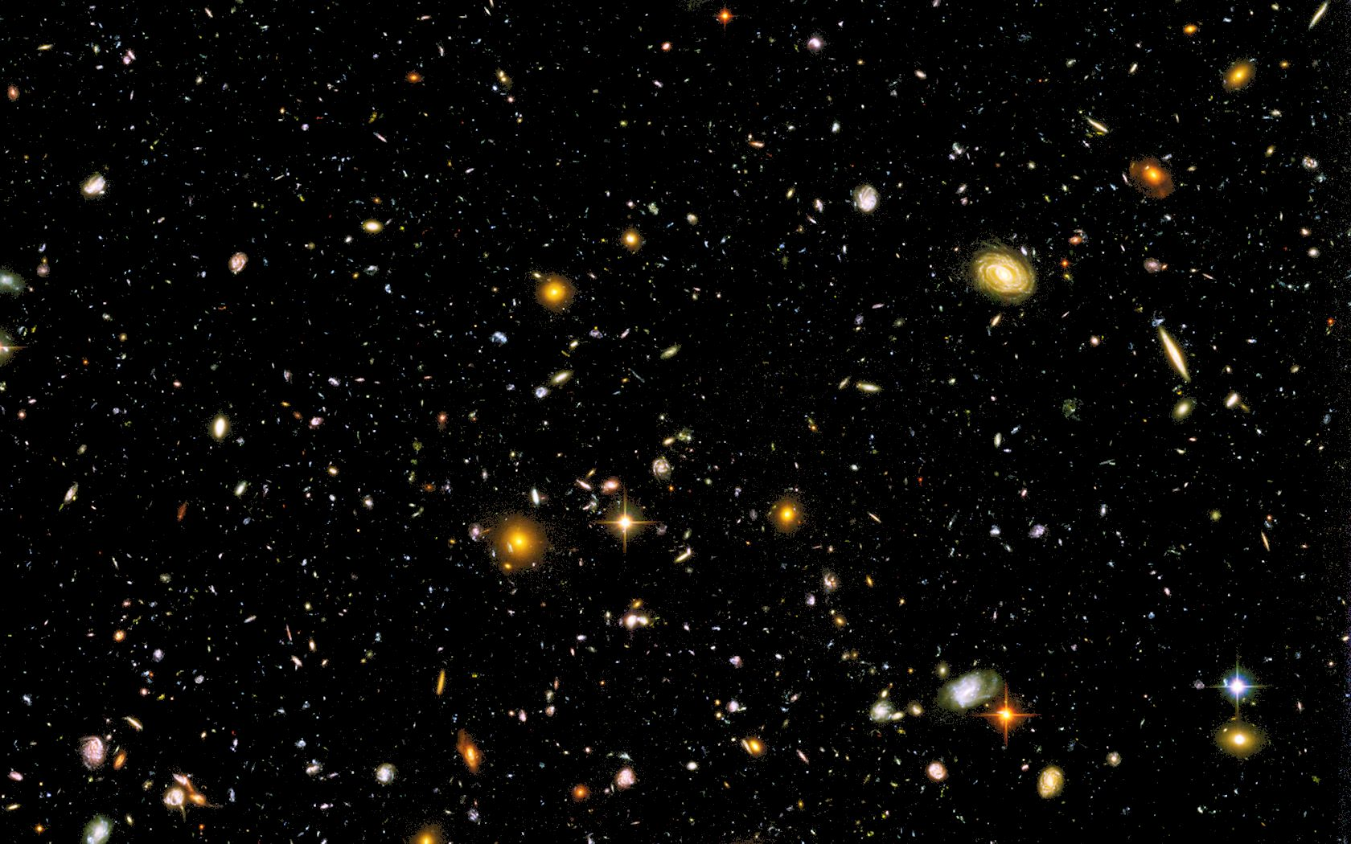
…in a Very Big Universe!
We are very, very small !

Slide 40
But everything is small when compared to God…
诸天述说 神的荣耀，穹苍传扬他的作为。 天天发出言语，夜夜传出知识。 没有话语，没有言词，人也听不到它们的声音。
The heavens declare the glory of God,
and the sky above proclaims his handiwork.
Day to day pours out speech,
and night to night reveals knowledge.
There is no speech, nor are there words,
whose voice is not heard. Psalm 19:1-3

Slide 41
Why do people choose Evolution?
It is NOT because of what they see through the telescope of the microscope
It is NOT based on scientific evidence
It is a choice from the heart:
“For although they knew God, they neither glorified him as God nor gave thanks to him, but their thinking became futile and their foolish hearts were darkened. Although they claimed to be wise, they became fools. They exchanged the truth about God for a lie, and worshiped and served created things rather than the Creator.” (Romans 1:21,22,25)

