Slide 1
Study Plan
1 | Is the Bible Trustworthy?
2 | Did God Really Create the World?
3 | If God is good, why does suffering exist?
4 | Why is evil so widespread and powerful?
5 | Why is Israel so important?
6 | Why did God punish Egypt so harshly?
7 | What is the purpose of the Ten Commandments?
8 | Are Biblical heroes all good guys?
9 | How do the Old and New Testaments fit together?
10 | Why did Jesus perform miracles?
11 | What did Jesus really say?
12 | Is death the end (or the beginning)?

Slide 2
Why is Evil so Widespread and Powerful?
How far will men go…?

Slide 3
From Last Week: Sin → Death (separation from life)
Genesis 2:16,17 > God gave complete freedom with only one command
Genesis 3:7-9 > After they ate the fruit, they hid themselves from God
  When someone dies physically, their soul is separated from their body
  When someone dies spiritually, their spirit is separated from God
Genesis 3:10-12 > Fear, Shame, and Guilt
Notes:
Last week, we saw that Adam and Eve chose to disobey God. The result of their actions was death: separation from God, and ultimately, separation of life from their bodies. In the first few pages of the Bible, we have discovered the cause of suffering and death - sin. The greatest sin of all : rejecting the almighty God. Separation from the source of life itself.
The remainder of the Bible contains the amazing story of how God is seeking to bring people back into a perfect relationship with Himself.

Slide 4
Moving away from the light of God
Into the darkness of rebellion
Lucifer
Satan
“Morning Star”
Enemy, Accuser
Man and Woman
“I will ascend to heaven”
“I will raise my throne”
“I will make myself like the Most High”
Notes:
As we said last week, when Lucifer (and people) walk away from the light of God, there is only one place to go: into the darkness of rebellion and sin.

Slide 5
From Last week: Clues to Remember
Genesis 3:9 > God came down and called out to the sinful man
  “Where are you?” An opportunity to confess sin
Genesis 3:17-18 > Thorns and Thistles on Earth
  Thorns: an image of the pain of sin
Genesis 3:21 > God covered their shame
  God allowed the death of an animal (a substitute) instead of the death of the man
  The first animal sacrifice:
    A constant reminder that sin causes death
    Leviticus 17:11 > The blood contains life (and forgiveness)
Notes:
We saw three clues in Genesis 3 about what God would do to bring people back to Himself:
1) He is came down to the sinful man and calling out to him, giving him the opportunity to repent
2) Because of sin, we see thorns and thistle grow up where good fruit should have been. We didn’t focus specifically on this last week (as a clue), but you will see later that thorns are a painful reminder of sin.
3) God killed and animal as a substitute death to cover the sin of man.

Slide 6
Three true stories about evil
Cain and Abel (Genesis 4)
The Great Flood (Genesis 6 – 9)
The Tower of Babel (Genesis 11)
Notes:
In this lesson, we will look at three true stories which show us how far men will go away from God. Unless God restrains evil, it will quickly consume us (and we will consume each other).

Slide 7
Cain and Abel - Genesis 4
Verses 1-2: Cain and Abel – both born sinners
Verses 3-5: Two sacrifices; two responses
  Abel : sacrifice of a lamb, following the example set by God in the garden – accepted
  Cain : sacrifice of fruits and vegetables, giving the result of his own work – rejected
    Cain offered a sacrifice that seemed good in his own eyes, but was not what God desired
    “Religion” = people try to please God with their own ideas and efforts.
Notes:
Since they were both separated from God by sin, Cain and Abel offered sacrifices to try and please God. In the garden, God had set the pattern of sacrifices by killing a lamb to cover the sin and shame of Adam. But Cain decided to do something different. He was a farmer, and chose to offer his best vegetables to God. To him, this seemed like a good thing – giving your best to please God
But God had already set the pattern of the right thing to do – the blood of the lamb was needed. Even though the animal sacrifice could not take away their sins, it demonstrated agreement with God’s truth that sin results in death. In pride, people try to please God with their own ideas and efforts – we often call this “religion” – man’s effort to save himself.

Slide 8
God’s Warning to Cain
Verses 6-7: Sin tries to trap people and take them further away from God.
Verse 8: Cain closed his mind to God’s warning, choosing sin again.
Verses 9-10: God “calls out” to Cain, giving him a chance to confess and repent.
The “blood cries out” – the Bible reminds us that blood represents life.
Verse 11: Sin always results in a curse
Notes:
Note that God is warning Cain about the temptation to add one sin to another. Sin isn’t a passive enemy – it actively pursues people, taking them further away from God. But Cain already had a plan to cover up his sin…
Genesis 4:9-10
Why does God call out to Cain? – Once again, we see God giving man an opportunity to confess and repent. We also see another reminder that blood represents life – figuratively, it cries out from the ground. Cain was cursed for his actions, made to be a “fugitive” on the earth (separation).

Slide 9
Things to Remember
Even the very best efforts of man cannot please God. He is God – His way is the only right way.
Notes:
We have a very sinful tendency to drag God’s glorious majesty down to human level (Psalm 50:21). When we do this, we assume that we can satisfy His expectations with our religious activities. But the actual fact is much more serious – our only hope is to submit completely to His way.
When we forget God’s holiness and awesome greatness, we move from an accurate fear of the Lord (Proverbs 9:10) to acting as though He needs our collaboration (Isaiah 40:14). Like Cain, we demonstrate our rejection of His definitions of good/evil and replace them with our own.
Inventing religions is a global practice, but it does not solve our biggest sin problem.

Slide 10
Genesis 5 – Adam’s children
Verse 3: Adam’s next son (Seth) – in man’s image
Verses 4,5: Adam lived 930 years with many sons and daughters
People lived a very long time (solar protection, stable climate, genetics slowly changed by sin)
Chapter 5 ~= 1500 years
Rapid growth of population and rapid growth of spiritual darkness
Notes:
The sad change: Initially, men were created in the image of God, but now, they inherit the sinful genetics of their parents (all the way down to us).

Slide 11
Genesis 6 – Evil on the Earth
Verses 5-7: How much wickedness (evil) was on the earth and in the people?
How did God feel about the wickedness?
What did He choose to do?
Verse 8: Noah – the only man on earth who pleased God.
Notes:
Notice that God sees the actions of mankind and the condition of their hearts. How did God feel about the wickedness on the earth?
God is creator, owner, and absolute authority. He had every right to destroy His creation, and would be perfectly just to do so.

Slide 12
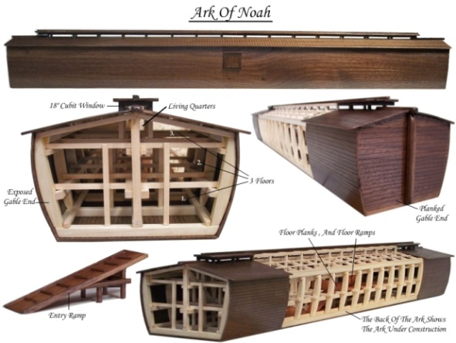
Genesis 6 – God’s plan
Verses 13-16: God warns Noah about the judgment and uses him to build a safe place.
100 years to build
Very large: 522 railroad boxcars
Very stable: same design used by modern ships
A box: it didn’t need to travel – just float.
Notes:
In Genesis 6:13-22, God tells Noah that He is going to destroy the people on the earth as well as the earth itself. God tells Noah to make an ark – a huge barge (522 Railroad Boxcars). God tells him exactly what to do, designing a very stable vessel. Over the next 100 years, Noah did everything just as God commanded.

Slide 13
Genesis 7 – The Great Flood
Verse 13: Only eight people entered the ark
Verses 15,16: God brought pairs of every animal to the ark. And then, God shut the door.
Verses 11,12: Water came from above and below, rising above all dry land (v.19).
Verses 23,24: Everything outside of the ark died
Ezekiel 33:11 How does God feel about death?
Notes:
On the appointed day, God brought the animals to Noah’s ark and shut them inside of the only safe place on earth.
God brought the animals to Noah (verse 15), and after they were all in the ark, God shut the door. In verses 17-24 we learn that the water came from above and below the earth (verses 11,12) 40 days, covering the mountains to a depth of more than 7 meters. Every person, land animal, and bird that was not inside of the ark died. The waters flooded the earth for 150 days.
God does not take pleasure in the death of the wicked.

Slide 14
The Great Flood : is it true?
Over 270 flood stories like this in cultures all over the world
Geology shows there was a major flood event:
  Canyons without deltas
  Rock layers bent and folded without cracks
  Rapid burial and fossil formation of plants and animals
  Clear boundary layers between sedimentary rock
Notes:
This story is not isolated to the Bible – there are over 270 flood stories like this in cultures all over the earth. Much evidence from geology shows that there was a major flood event, including canyon formation without deltas, sharp layers of sedimentary rock, folded without cracking, and rapid burial/fossilization of plants and animals (including ones that penetrate multiple layers of rock). I can share more information later if interested.

Slide 15
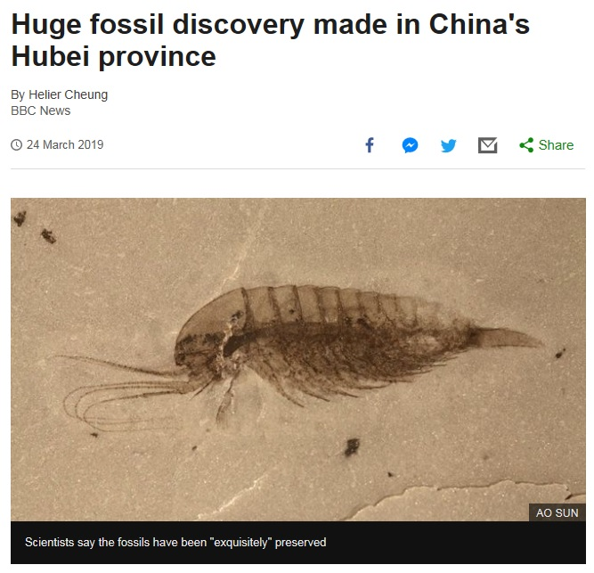
Notes:
A recent discovery in China shows the same reality that is found all over the world – geology indicates a massive flood event that resulted in huge, mixed fossil deposits all over the world.

Slide 16
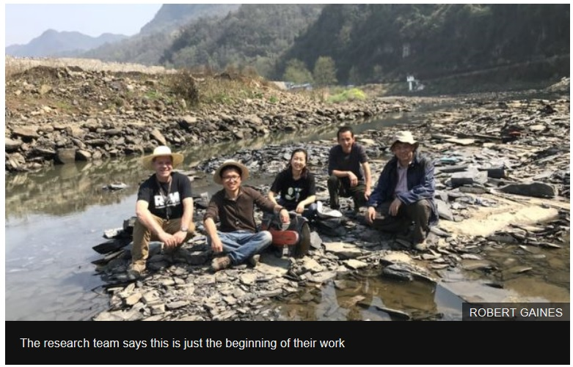

Slide 17
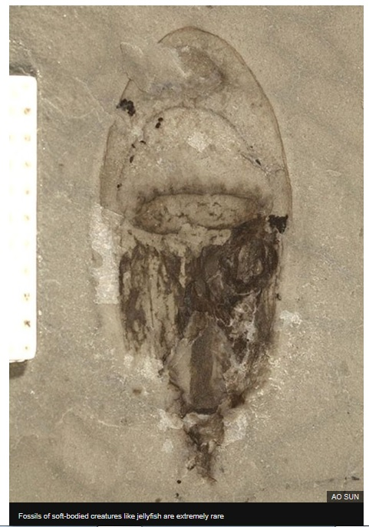
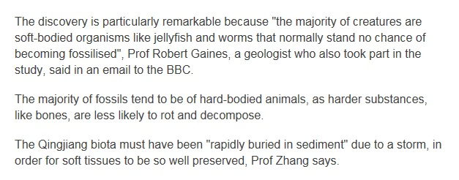
Notes:
What does it take to make a fossil? When an animal or plant dies, it lies on the ground (or just under the surface) and rots away.
To make a fossil requires rapid burial, high pressure and very special conditions. Like those in the great flood…

Slide 18
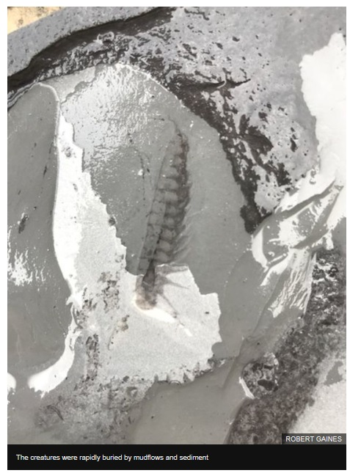
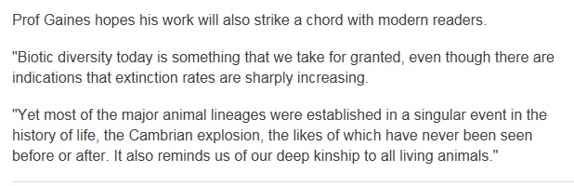
Notes:
It is interesting to consider the fact that, every year, we see thousands of species go extinct, but we never see new ones emerging (i.e. we don’t see evolution happening, we see the opposite).
I love their conclusion: a singular event caused all of these diverse fossils, and it was one that had never been seen before or would be after.

Slide 19
Things to Remember
Even the very best efforts of man cannot please God. He is God – His way is the only right way.
In the midst of judgment for sin, God shows mercy, providing a safe place.
Notes:
Throughout the Bible, you will see pictures of God showing judgment and mercy (e.g. warning Noah and closing the door). Here, we see another clue about God’s plan – in the midst of judgment, He provides a place for men to survive. But the only safe place of survival is the one that He provides.

Slide 20
God’s Commands and Man’s Response
Genesis 9:1 What did God tell the people to do?
  Fill the earth = travel and spread out
Genesis 11:1,2 How many languages on the earth?
  Just one (中文? ☺)
Genesis 11:3,4 Did people obey God?
  No, they did not want to spread out across the earth
What name did they want to lift up?
Isaiah 43:7 What name should people lift up?
Notes:
After the flood, were people better? No, the inclination of the human heart is still evil.
What command did God give to Noah and his descendants? – God told the people to multiply and spread out over the earth. But man desires to do their own thing…
What does this say about the language on the earth at this time? (maybe everyone spoke Chinese ☺). What did the people want to do and why did they want to do this? God told them to spread out, but they wanted to stay together to make a name for themselves.

Slide 21
Things to Remember
Even the very best efforts of man cannot please God. He is God – His way is the only right way.
In the midst of judgment for sin, God shows mercy, providing a safe place.
God created people for His glory, but people are proud and seek their own glory.
Notes:
As I said earlier, the most serious sin of all is to reject the Creator God of the universe. When we choose to seek our glory instead of His, we are actually doing just that – putting ourselves into His place, making ourselves God.

Slide 22
God’s Response to Man’s Evil
Genesis 11:5,6 What did God say about the men?
  With common language and goals, they will accomplish everything that they plan.
Is the power of man a good thing or bad thing?
  When it is against God, it is always a bad thing.
Genesis 11:7-9 Did God destroy the evil men?
  No, He multiplied their languages to force them to spread out. Again, we see mercy in judgment.
Notes:
Who is the “Us” in verse 7? What did the Lord say about the people’s plan? What was the result of God’s introduction of confusion? Once again, the people directly disobeyed God. Why didn’t He just destroy them? This is another good example of God balancing His judgment with His mercy. When I struggle with Chinese, I must remember that our language difference is a result of His mercy!
The people gathered there because they did not want to be scattered over all the earth as God commanded. These men were full of pride! They should have been interested in exalting God’s name, not their own.

Slide 23

Global Languages remind us that, even in His judgment, God shows mercy.
Notes:
Linguists tell us that, apart from this story of Babel, there is no good explanation for the diversity of languages that exist on the earth.
Studies have determined that there are about 6900 distinct languages around the world, originating from about 15 unique “protolanguages.”
Studies have also shown that, over time, language tends to devolve from complex to simple, not the other way around.

Slide 24
Things to Remember
Even the very best efforts of man cannot please God. He is God – His way is the only right way.
In the midst of judgment for sin, God shows mercy, providing a safe place.
God created people for His glory, but people are proud and seek their own glory.
Evil is real and always pulls men away from God. We have only one hope – God must bring us back to Himself.
Notes:
Tonight, we saw three stories from the Bible demonstrating the evil of mankind. If humans are allowed to do whatever they want, they quickly descend into evil and away from God.
But even though God should have destroyed them, God did not. He continued to show mercy over and over. And He continues to show mercy to us…

Slide 25
Evil is Inside Everyone
Our culture says our problem is on the outside and the solution is on the inside.
When we pray “deliver us from evil,” we must recognize that the evil inside of us is our greatest danger (Matthew 6:13; James 1:14,15)
Although we may be able to run away from the evil outside of us, we cannot run from ourselves.
Only God’s grace has the power to rescue us from the most threatening evil of all—the evil that still resides in our hearts.
Notes:
Modern psychology assumes that our big problems are outside of us: societal pressures, financial hardships, unfairness, drugs and alcohol, temptations, etc. It then tries to reach inside of a person and use their “inner strength” to achieve a solution.
But this is not the reality we experience and is certainly not the message of the Bible. The Bible is clear that we all are born with a sin nature, “magnetizing us” to opportunities for sinful actions around us.
Our sinful nature (on the insider) can only be overcome by a greater power from God (on the outside).

Slide 26
Things to Remember
Even the very best efforts of man cannot please God. He is God – His way is the only right way.
In the midst of judgment for sin, God shows mercy, providing a safe place.
God created people for His glory, but people are proud and seek their own glory.
Evil is real and always pulls men away from God. We have only one hope – God must bring us back to Himself.
(next week, the first step in His plan…)

Slide 27
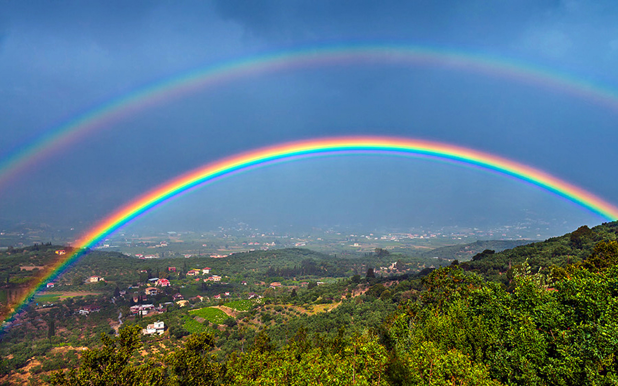
神说："这就是我与你们，与一切跟你们同在有生命的活物所立之约的记号，直到万代； 我把彩虹放在云彩中，作我与大地立约的记号。 出现云彩中， 我就记念我与你们和一切有生命的活物所立的约：水不再成为洪水，来毁灭凡有生命的
And God said, “This is the sign of the covenant that I make between me and you and every living creature that is with you, for all future generations: I have set my bow in the cloud, and it shall be a sign of the covenant between me and the earth. And the waters shall never again become a flood to destroy all flesh. Genesis 9:12,15
Notes:
Yes, there is evil (bad news). But there is also hope.
Remember Ezekiel 33:11 – God does not take pleasure in the death of the wicked. He has a plan to rescue sinful people…

